Slide 1

COMPARATIVE MACHINE LEARNING APPROACHES FOR EARLY PREDICTION OF CHRONIC DISEASES ONSET
DEPARTMENT OF COMPUTER SCIENCE
JAWAHARLAL NEHRU TECHNOLOGICAL UNIVERSITY HYDERABAD
UNIVERSITY COLLEGE OF ENGINEERING SCIENCE AND TECHNOLOGY
DISSERTATION STAGE-I
DISSERTATION WORK REVIEW-I
AUGUST-2026
PRESENTED BY:
Aechikuchi Rakshitha
22011P0517
V-I SEMESTER
CSE-IDP
UNDER THE GUDIENCE OF
DR. V. Uma Rani
Professor of Computer Science & Engineering,

Slide 2
AGENDA
Abstract
Introduction
Problem Statement
Motivation
Objectives
Literature Review
Architecture
Evaluation Metrics
Conclusion
References

Slide 3
ABSTRACT
Chronic diseases such as diabetes and heart failure are major global health concerns, making early prediction important for timely intervention and improved patient outcomes. This study applies machine learning techniques to clinical data for early prediction of these diseases. Logistic Regression, Random Forest, and XGBoost are trained and evaluated using accuracy, precision, recall, F1-score, and AUC-ROC. Clinical features such as glucose, BMI, blood pressure, age, ejection fraction, and serum creatinine are analyzed to identify important predictors. Finally, the models are compared across both diseases to determine their predictive performance and generalizability.
3

Slide 4
INTRODUCTION
Diabetes and heart failure are major chronic diseases that create significant health burdens.
Early identification of individuals at risk is important for timely intervention and better patient outcomes.
Traditional diagnostic approaches may identify these conditions only after clinical symptoms have progressed.
Machine learning provides a data-driven approach that can analyze patient health information and identify patterns associated with disease risk.
This study uses structured Electronic Health Record (EHR) data, including clinical attributes such as glucose, BMI, blood pressure, age, ejection fraction, and serum creatinine.
The study compares Logistic Regression, Random Forest, and XGBoost for early prediction of diabetes and heart failure.
4

Slide 5
PROBLEM STATEMENT
Diabetes and heart failure are major chronic diseases that require early detection and timely intervention. Traditional diagnostic methods may identify these conditions only after symptoms or complications have developed. Although machine learning can help predict disease risk using clinical data, the performance of different models may vary across diseases. Therefore, this study aims to compare Logistic Regression, Random Forest, and XGBoost for early disease prediction and identify the most influential clinical features using appropriate evaluation metrics.
5

Slide 6
MOTIVATION
Increasing prevalence of diabetes and heart failure worldwide.
Need for early disease prediction to support timely intervention.
Traditional diagnosis may identify diseases after symptoms or complications develop.
Availability of clinical/EHR data provides opportunities for data-driven prediction.
Machine learning can identify hidden patterns and important risk factors in clinical data.
Different ML models may show different predictive performance across diseases.
Need to compare Logistic Regression, Random Forest, and XGBoost.
Identify important clinical features that contribute to disease prediction.
Support the development of reliable machine learning-based clinical decision support.
6

Slide 7
OBJECTIVES
Collect
Preprocess
Analyze
Build
Evaluate end compare
Identify
7

Slide 8
LITERATURE REVIEW
Machine Learning for Diabetes Prediction
Machine Learning for Heart Failure Prediction
Comparative Analysis of ML Models
Clinical Feature Importance
Evaluation Metrics in Healthcare Prediction
Existing Limitations
Research Gap
8

Slide 9
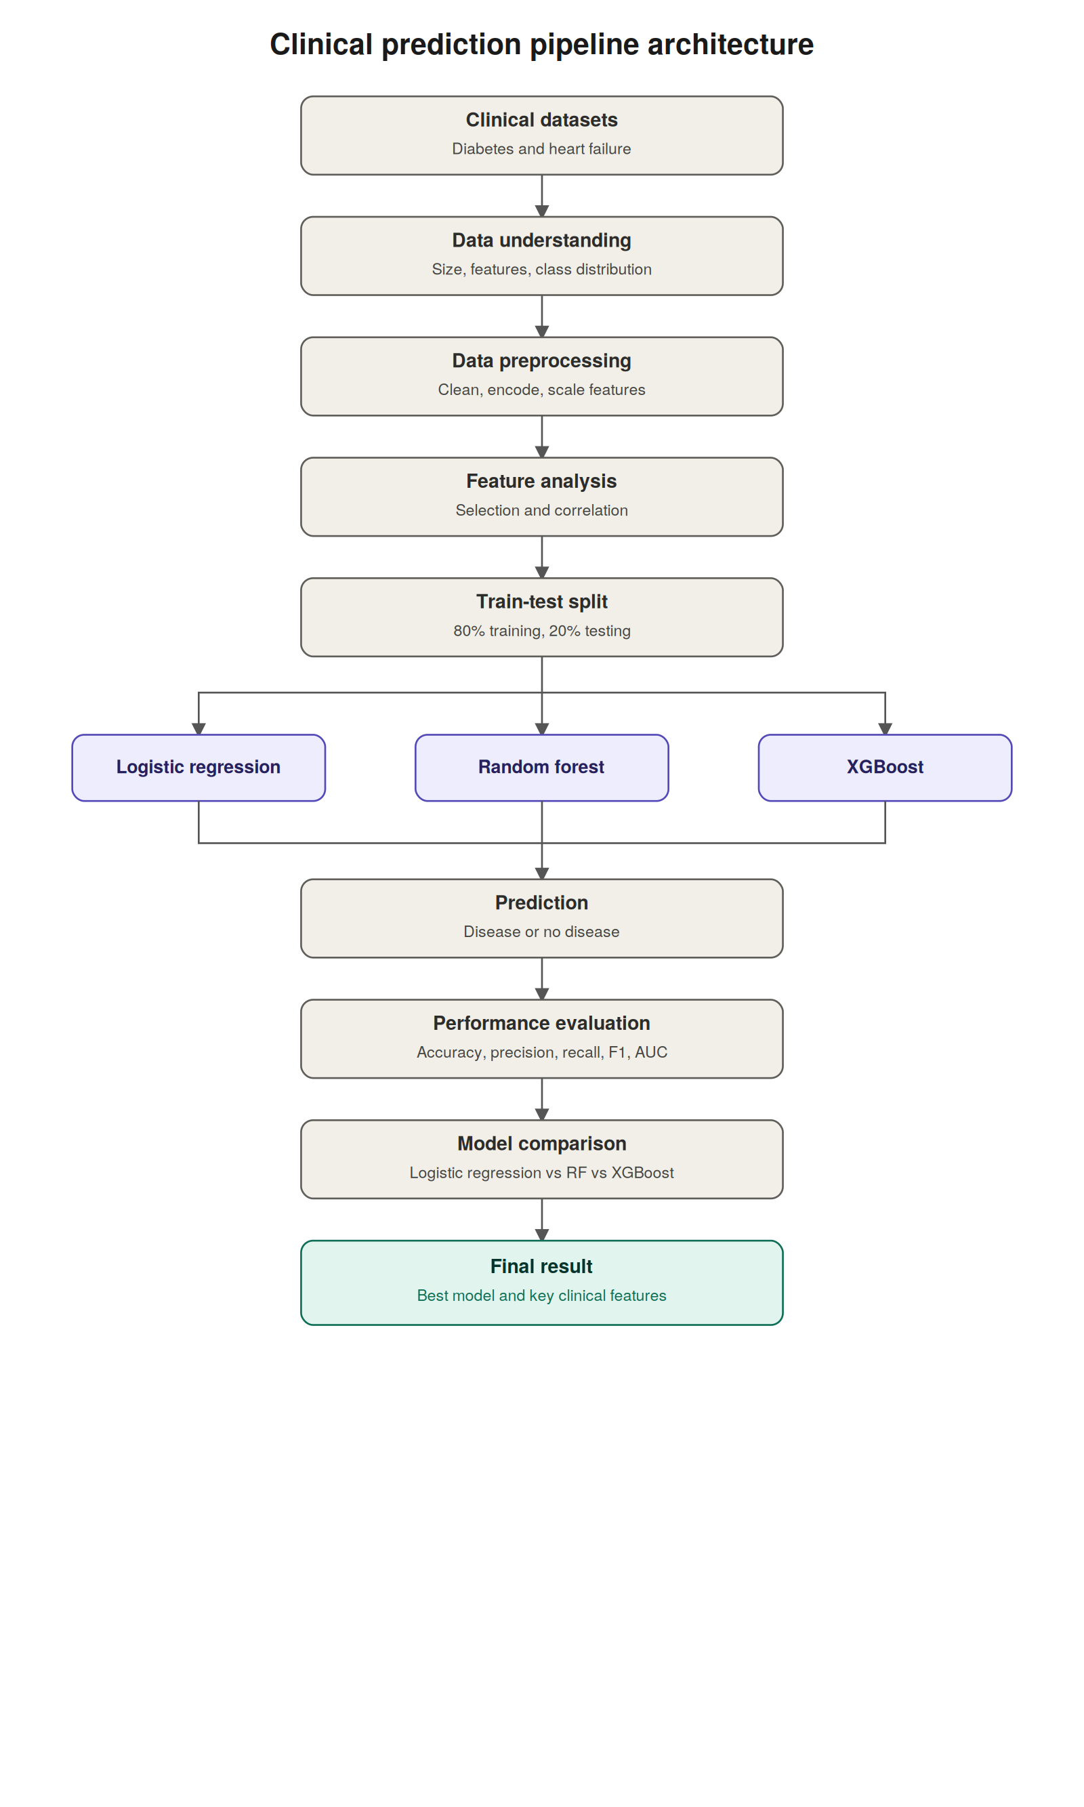
ARCHITECTURE
9

Slide 10
EVALUATION METRICS
METRIC | PURPOSE
Accuracy | Measures the overall percentage of correct predictions.
Precision | Measures how many predicted positive cases are actually positive.
Recall | Measures how many actual positive cases are correctly identified.
F1-Score | Provides a balance between Precision and Recall.
AUC-ROC | Measures how well the model distinguishes between positive and negative classes.
10

Slide 11
CONCLUSION
To conclude, our project focuses on using clinical data for early prediction of diabetes and heart failure. We will implement three machine learning models and evaluate them using the same set of metrics. Finally, we will compare their performance and identify important clinical features. Since this is a proposed study, the final conclusion about which model performs best will be based on our experimental results.
11

Slide 12
REFERENCES
Khokhar, P. B., Gravino, C., & Palomba, F. (2025). Advances in artificial intelligence for diabetes prediction: Insights from a systematic literature review. Artificial Intelligence in Medicine, 164, 103132.
Accuracy of Machine Learning Classification Models for the Prediction of Type 2 Diabetes Mellitus: A Systematic Survey and Meta-Analysis Approach. (2022).
Performance of diabetes risk prediction models: A systematic review and meta-analysis. (2025).
Xu, Z., Hu, Y., Shao, X., et al. (2025). The Efficacy of Machine Learning Models for Predicting the Prognosis of Heart Failure: A Systematic Review and Meta-Analysis. Cardiology, 150(1), 79–97.
Comparing Machine Learning Models and Statistical Models for Predicting Heart Failure Events: A Systematic Review and Meta-Analysis. (2022).
Scrutinio, D., et al. (2025). Prediction of mortality in heart failure by machine learning. Comparison with statistical modeling. European Journal of Internal Medicine
12

Slide 13
THANKYOU
13

